Slide 1

Final Project CREDIT CARD FRAUD DETERCTION
Course: Knowledge Discovery in Databases (MIS 637)
Department: Business Intelligence and Analytics (BIA)
Presented By: Saketh Patibandla
ID: 10413333
Instructor: Prof. Mahmoud Daneshmand

Slide 2

Introduction
Security is a vital part of every bank’s business and as credit cards are major for their business, it is crucial that credit card fraud should be kept in check.
New York Times has claimed that most of the American users with accounts in the United States are susceptible to fraud and more than 1% of users encounter this problem.
To prevent credit card fraud, first an analysis on where fraud is occurring and how it can be detected with a good accuracy should be understood.
These facts have led experts to believe that time and money should be invested in detecting fraud through data science, machine learning and analysis of transaction data to find reasons and factors related to Credit Fraud.

Slide 3
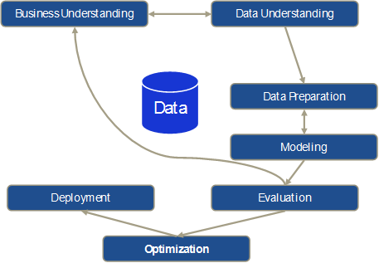
CROSS-INDUSTRY STANDARD PROCESS (CRISP-DM)
We will use CRISP-DM to solve the problem at our disposal. This data mining technique has 6 different phases.
Business Understanding (What problem are we going to address?)
Data Understanding (What data are we going to use, from where, getting used to it)
Data Preparation (Selection of relevant data after transformation, cleaning and handling outliers)
Modeling (Selection of best data processing algorithm on optimization and alternative model discussion)
Evaluation (Determine accuracy and evaluate, test if project meets objectives)
Deployment (Release the observed results into production, enhance business on generating reports to guarantee success for the algorithm)

Slide 4
Business Understanding
Profound Question:
To detect if a credit card transaction in Europe in September 2013 is fraudulent using real time transaction data that was taken from a partner bank with the ULB and predict accuracy to reduce credit card fraud.
Goal:
To use data mining techniques and predict whether a transaction made by a person is safe or fraudulent and to determine the best algorithm using model accuracy and precision rules.
Accomplishments:
Since fraudulent transactions can be predicted with a high accuracy, the bank can properly track credit card defaulters of their customers and report them to the police. Further, since the best model is also predicted here, it can be recommended on a global scale to monitor credit card fraud and a good relationship between the customers and the financial organization.

Slide 5
Data Understanding
Data source:
The dataset has been collected during a research collaboration of Worldline and the Machine Learning Group of ULB (Université Libre de Bruxelles) of Brussels on big data mining and fraud detection.
The dataset contains transactions made by credit cards in September 2013 that belong to cardholders across Europe.
This study was made to first find the spread of fraudulent users and then identify how many are being done and as a project to the University, we will successfully help ULB in finding out the best algorithm out of three good machine learning algorithms.
This data was obtained from http://mlg.ulb.ac.be

Slide 6
Data Understanding
Dataset details: Credit card transaction dataset
This is a huge dataset with 284,807 records out of which 492 are fraudulent and the other 284309 are clean transactions.
There are 31 attributes in the dataset out of which 29 are features for fraud detection, and one target variable.
The target variable is the only variable that classifies people as a person committing fraud or a clean person who does not commit any fraud.

Slide 7
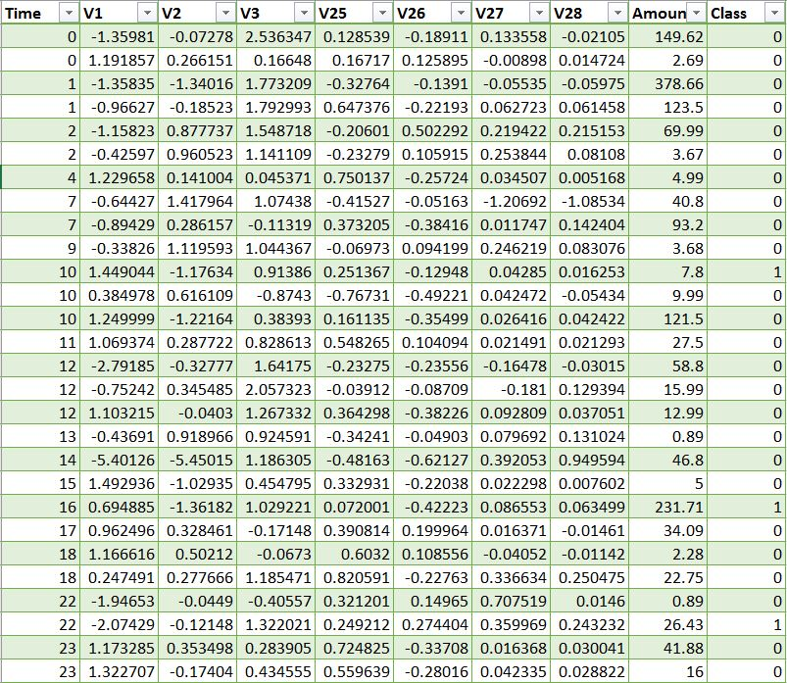
Data Understanding
Data Sample:

Slide 8
Data Understanding
Attribute details:
Time: The number of seconds elapsed between each transaction and the first selection of the dataset.
Amount: The amount of money used by the cardholder in the respective transaction.
V1 – V28: V1 to V28 are 28 principal components extracted on performing a comprehensive Principal component transformation/analysis (PCA).
Target: ‘Class’ or the target variable is the responsible variable. It is binary and shows 1 in case of fraud and 0 otherwise.

Slide 9
Data Preparation
For data preparation the data set will be cleansed and transformed. The data set
is reviewed for the following :
Handling the missing values and outliers if any.
Finding attributes that require transformation in the data.
Selecting the appropriate values necessary for analysis.

Slide 10
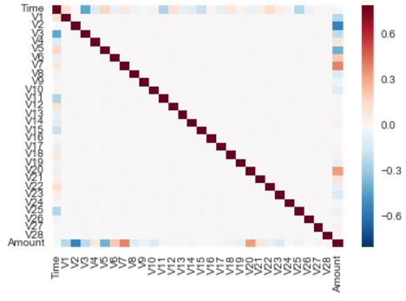
Data Preparation
Heat map to verify correlation between the components.
A straight line suggests that it was correctly performed.
Feature Engineering: (PRINCIPAL COMPENENT ANALYSIS)
Before getting to the point where we find outliers, remove them or normalize the data or see which data is used for which iteration, a prime component of this data is the PCA.
The features that were obtained in the data were obtained by choosing numerical data such as details of customers, transaction location, Business of the merchant and other details that are kept confidential due to the university and credit card issuing authority policy.
From a total of 43 attributes that were present in the banks database, a PCA was run and 28 important features were obtained.

Slide 11
Data Preparation
Handling the missing values: Since this data was collected manually and through remote systems, the data was accurate and no missing values exist.
Transformation: The attribute ‘Amount’ was Normalized while running the last iteration because a clear imbalance was seen that was affecting the precision of the model output.
Outliers: This data does not have any outliers as it is a combination of features and Binary variables.
Irrelevant Data handling: The variable ‘Time’ was deemed irrelevant after a few iterations and was ignored from the main calculations.

Slide 12
Data Preparation
Division of data for machine learning:
The set shown previously that consisted of 284,807 is now divided into 2 parts:
Training Set 1: It consists of 75% of the data which is 213,605 transactions.
Training Set 2: It consists of 80% of the data which is 227,846 transactions.
Test Set 1: It consists of 25% of the data which is 71,202 transactions.
Test Set 2: It consists of 20% of the data which is 56,161 transactions.
The case 1 is used for 3 iterations and the case 2 is used for the remaining 5 iterations.
Since, an accuracy comparison study is being performed here, this split is pivotal.

Slide 13
Modeling - Tools
Let us study about the tools and the libraries that are being used to execute our problem.
Tools:
->Python (3.2) for writing code to execute and find out accuracy of the problem.
->Jupyter (ipnyb) to have a proper flow through the code in the form of a notebook
Libraries:
-> Pandas, Numpy are used for storage, tracking, data frames and data handling.
-> Mathplotlib is used for visualizing data.
-> XGBoost, DTClassifier, RFClassifier, Scikit-learn are used to perform machine learning algorithms.

Slide 14
Modeling
In the next stage, we need to select a modeling technique to execute this problem.
Here, the relationship between dependent and independent variables is derived from the data selected.
The question which pattern matches which data is clearly answered by using Machine Learning algorithms.
Why do we need machine learning algorithms?

Slide 15
Modeling
Since the data that is being dealt with is binary and needs to be classified into either fraudulent or non-fraudulent data, three suitable machine learning algorithms are used in this case to perform data mining on credit card transactions.
-> Random Forest Classifier.
-> Decision Tree Classifier.
-> XG Boost algorithm.

Slide 16
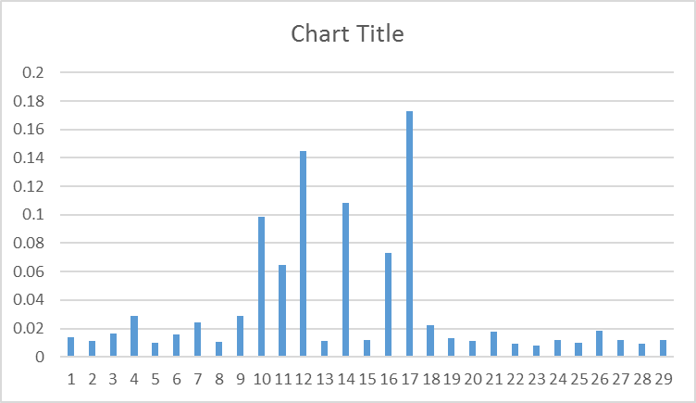
Modeling – Random Forest Classifier
A technique based on decision trees, Random Forest is an advanced ensemble learning method to classify the data into significant classes.
The advantages of Random Forest are:
-> It has very low sensitivity to outliers.
-> A very high accuracy is obtained.
The disadvantages of Random Forest Classifier is that it is:
-> Highly time consuming.
Graph with features and their group

Slide 17
Modeling – Decision Tree Classifier
A decision tree classifier is an upgrade on the CART algorithm and it is a predictive modeling technique that uses classification trees and conjunctions to solve problems on classifications.
Data is in the form of (x,Y) -> (x1, x2, x3, ……. Xk, Y)
The advantages are:
-> Highly detailed.
-> Very good accuracy.
Disadvantage is that:
-> Decision Tree classifiers are very slow and time consuming to execute.

Slide 18
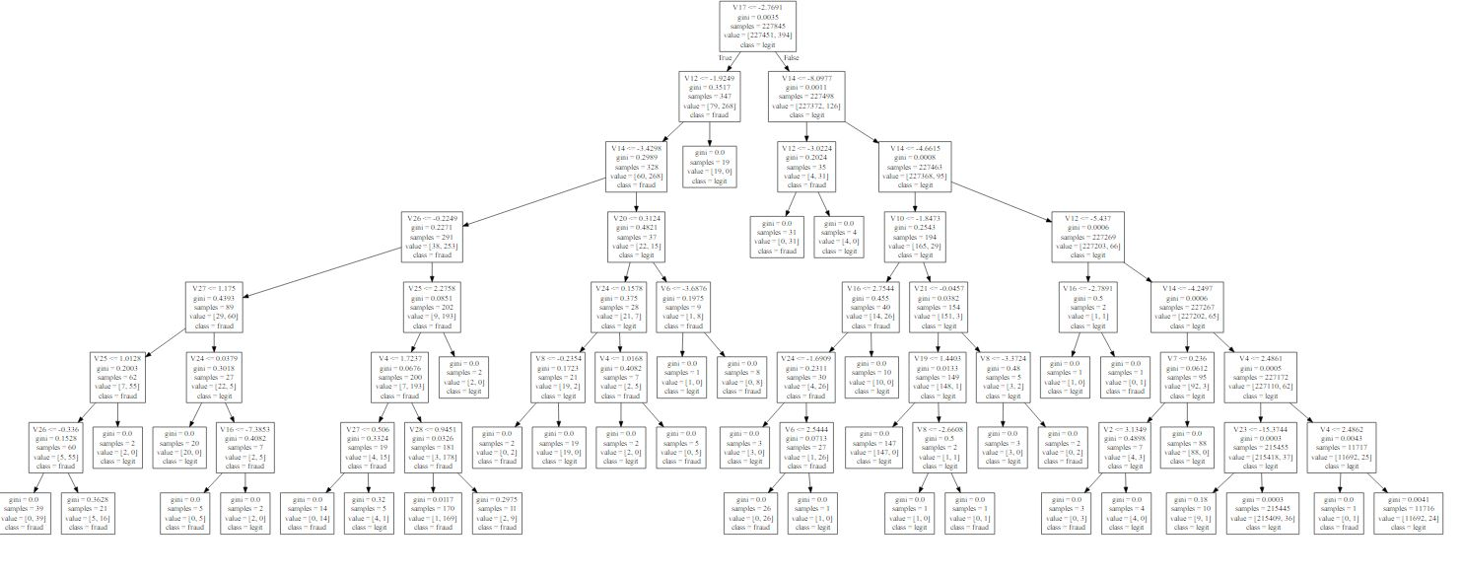
Modeling – Deriving Rules for Decision Tree
Based on the features obtained by Principal Component Analysis, from V1 to V28, rules have been derived below for Decision Trees.

Slide 19
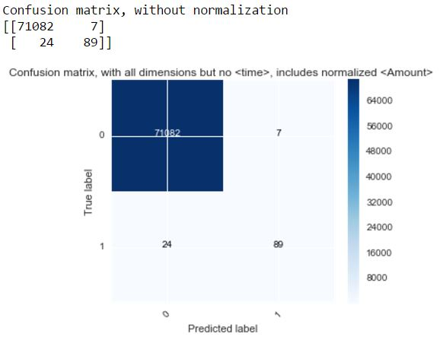
Evaluation – Random Forest Classifier & Decision Tree Classifier
RFC = Random Forest Classifier
DTC = Decision Tree Classifier
1) First Pass - RFC including all dimensions in data set with test_size =0.25
2) Second Pass - RFC including all dimensions but time in data set with test_size =0.25
3) Third Pass - RFC including all dimensions but (time,amount) in data set with test_size =0.25
4) Fourth Pass - RFC including all dimensions but time, includes normalized amount with test_size =0.25
5) Fifth Pass - RFC including all dimensions but time, includes normalized amount with test_size =0.2
6) Sixth Pass - DTC with max_depth=6, including all dimensions but time, includes normalized amount with test_size =0.2
7) Seventh Pass - DTC with max_depth=7, including all dimensions but time, includes normalized amount with test_size =0.2
Confusion Matrix for Random Forest – describing fraud and legit rate.

Slide 20
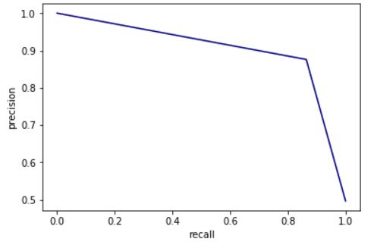
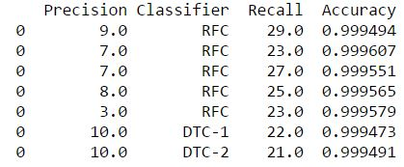
Evaluation – Random Forest Classifier & Decision Tree Classifier
Analysis:
To explain the previous part, 7 iterations are run with different training and testing datasets as mentioned in the input and the accuracies and the precisions from the chart were obtained.
Since, this is a credit card fraud detection dataset, more than the accuracy,
The recall and precision relationship is pivotal, as shown in the below figure.

Slide 21
Modeling – XG Boost Technique
An implementation of Gradient Boosted decision trees which is a machine learning technique for regression
Or classification problems which produces a prediction model in the form of an ensemble of weak
Prediction models.
Typical, an advanced model of decision trees.

Slide 22
Evaluation – All 3 algorithms
Random Forest Classifier: Produces the Best accuracy, but not good predictor and recall.
Decision Tree Classifier: Produces consitent accuracy with best predictor and recall.
XGBoost: Produces a low accuracy of 89% and is eliminated.
Hence, we select Decision trees to solve our problem.

Slide 23
Deployment
This is the final phase of the CRISP – DM Procedure.
To ensure the model’s success, a small set of data is deployed of the previous models will be deployed on the scene.
A simple report of the same results was provided to ULB and was uploaded on github.com/spatiban.
Now, the deliverables are compared to the expected deliverables and will hopefully be executed to reduce the number of Fraudulent transactions in Europe.
Now, the bank can use the algorithm and deploy it to people to solve cases.

Slide 24
Conclusion
By executing this model, ULB can now help the European bank to prevent Credit card fraud by deploying the Decision Tree Classifier which has been concluded as the best technique to catch users who perform credit card fraud.
Now, since the ‘Class’ attribute has been successfully predicted, the number of fraudulent transactions can be reduced by deploying this algorithm with 99.7% accuracy to detect credit card theft.

Slide 25
References
www.kaggle.com (kaggle)
www.kdnuggets.com (Kdnuggets)
http://www.analyticbridge.com/profiles/blogs/random-forest-in-python (Random Forests)
http://mines.humanoriented.com/classes/2010/fall/csci568/portfolio_exports/lguo/decisionTree.html (Decision Tree Classifier)
http://scikit-learn.org/stable/modules/generated/sklearn.tree.DecisionTreeClassifier.html (Decision Tree Classifier)
https://www.sas.com/en_us/insights/analytics/machine-learning.html (Machine Learning)
http://xgboost.readthedocs.io/en/latest/model.html (XGBoost Trees)

Slide 26
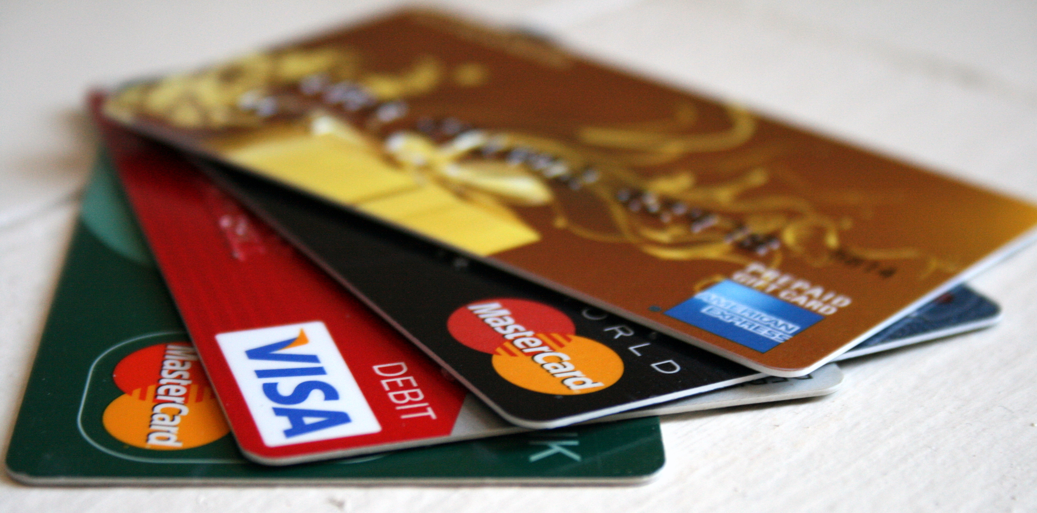
THANK YOU

